Slide 1
مشيئة من ؟
1 ملوك 22
د. ريك جريفيث, مؤسسة الدراسات اللاهوتية الأردنية cicfamily.com & BibleStudyDownloads.org

Slide 2
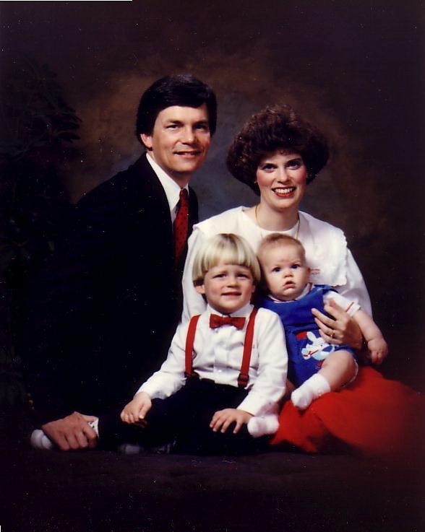
20 شباط 1991م: الإنتقال إلى سنغافورة
ريك، 33 سنة
سوزان، تقريبًا 30
كيرت، 4
ستيفن، 1
Notes:
خدمتُ بوظيفة أستاذ جامعي في كلِّيَّة سنغافورة للكتاب المقدَّس مدَّة 30 عامًا، وفي خدمة تعليم الكتاب المقدَّس، واللاهوت، والوعظ.
________
Common-61

Slide 3
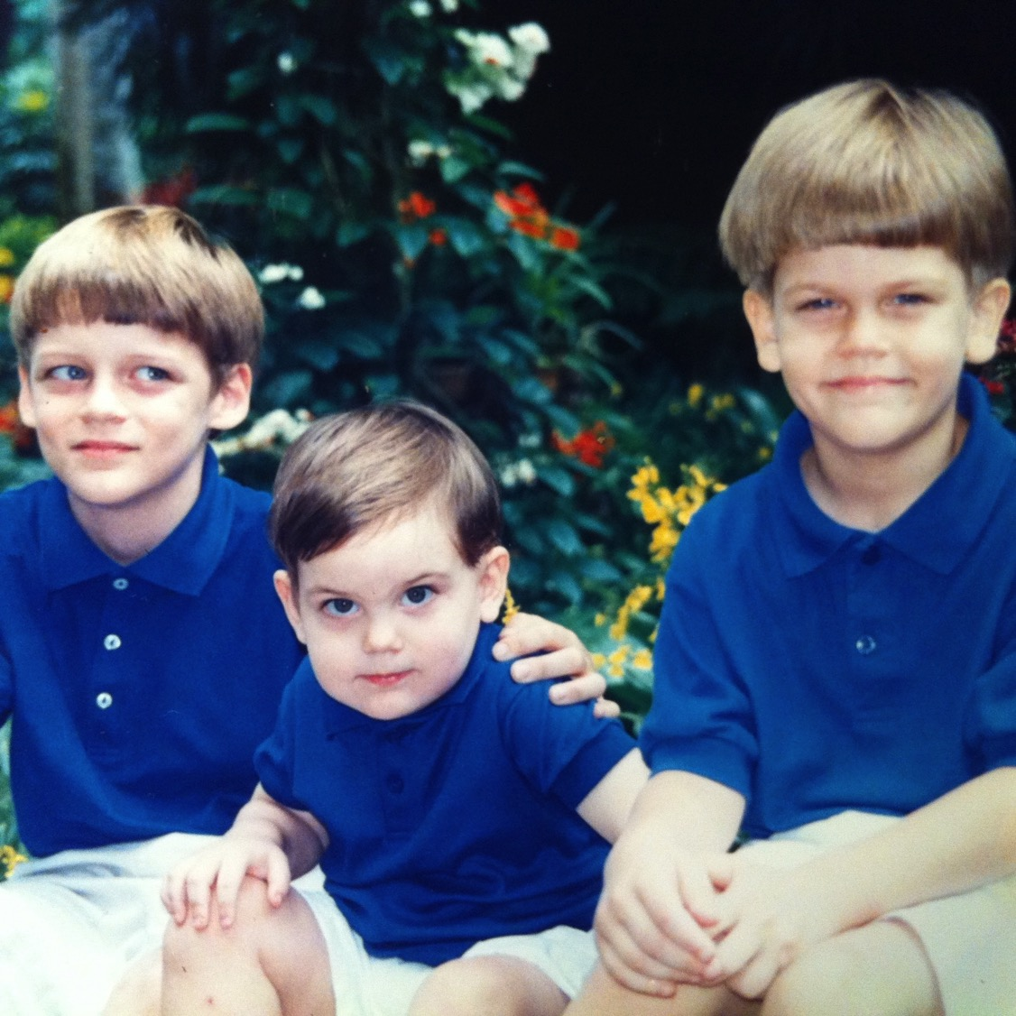
أولادنا الثلاثة
Notes:
قمنا بتربية ثلاثة أولاد في سنغافورة حتَّى وقت انتقالهم إلى الولايات المتَّحدة الأميركيَّة للدراسة الجامعيَّة.
________
Common-62

Slide 4
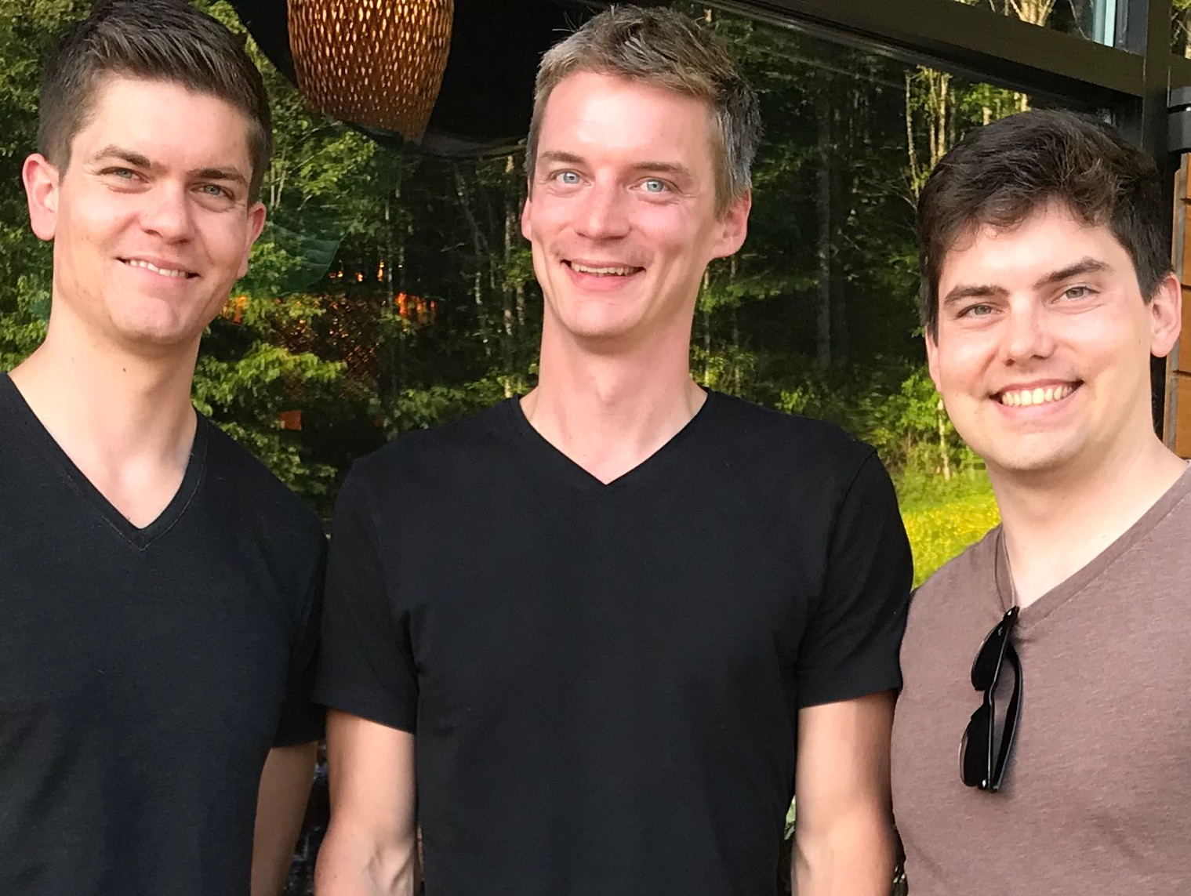
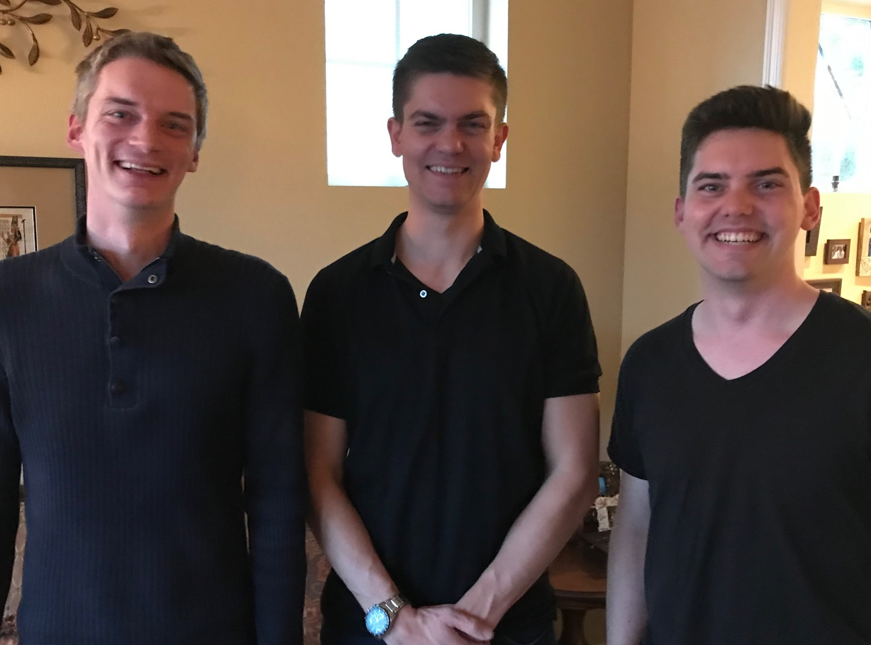
أولادنا الثلاثة
Notes:
أصبح أولادنا الثلاثة جميعهم بالغين الآن.
The sons are all grown up now.
___________
Common-63

Slide 5
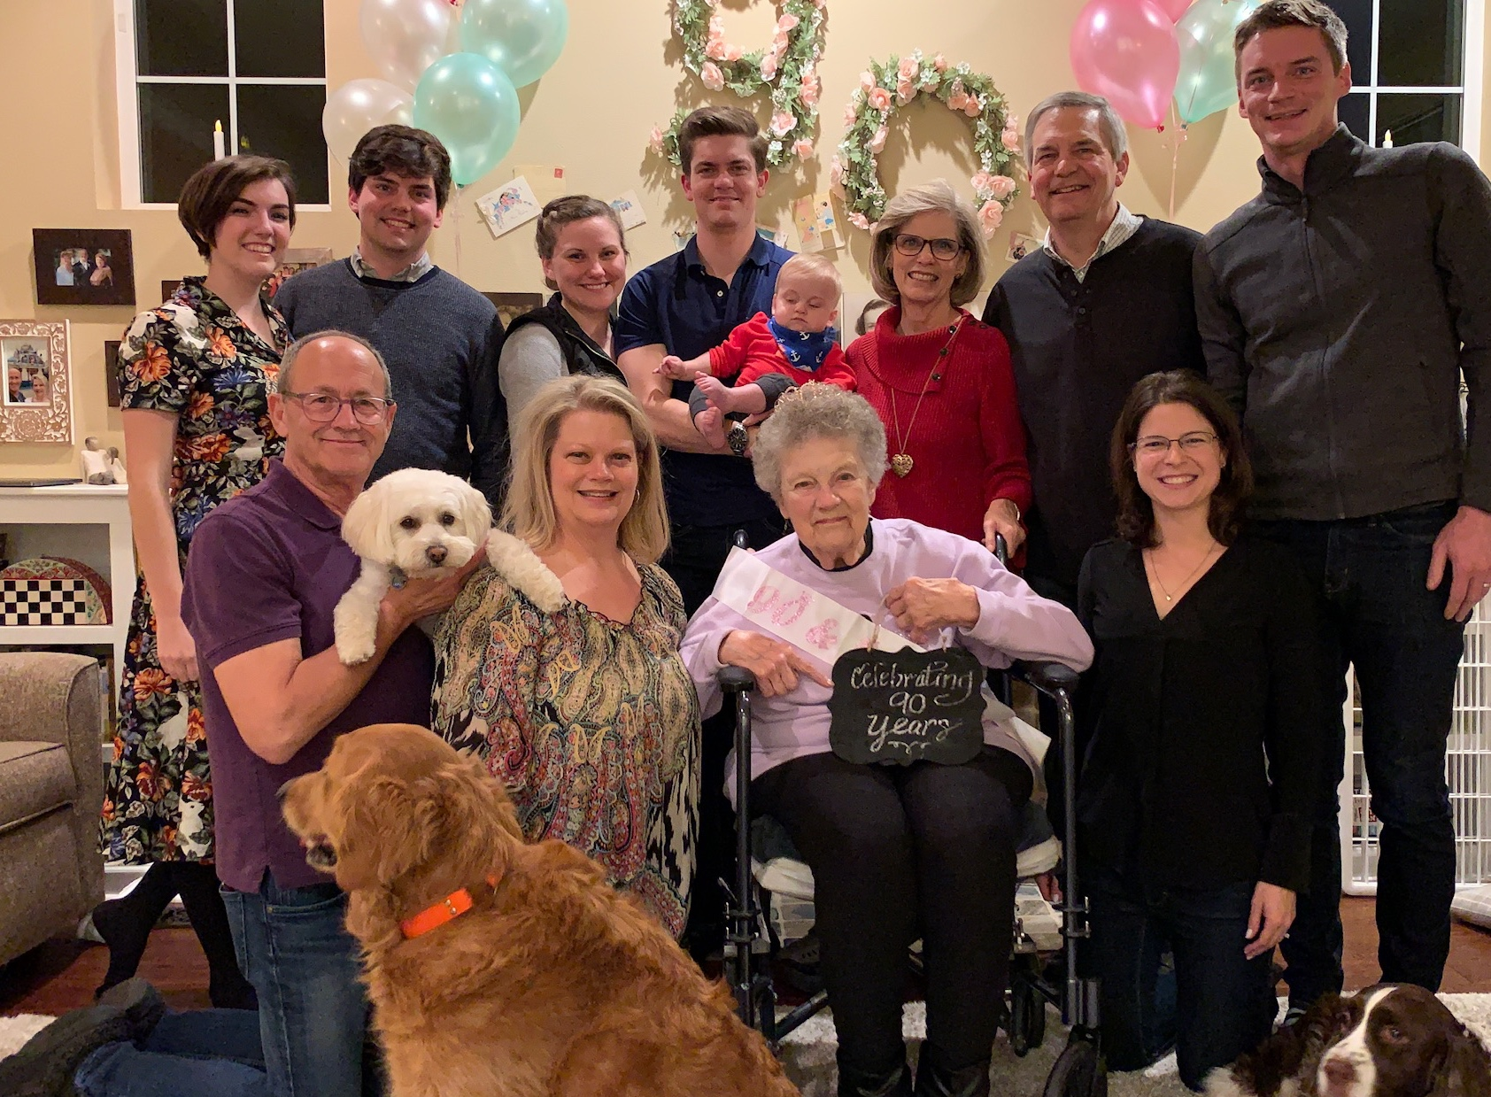
عائلة جريفيث 28 تشرين ثاني 2019
2020
ريك وسوزان
جون وكلوي (29)
كيرت وكارا (35)
ستيفن وكيتي وجيسي (32)
Notes:
جميع أولادنا متزوِّجون الآن.
___________
Common-64

Slide 6
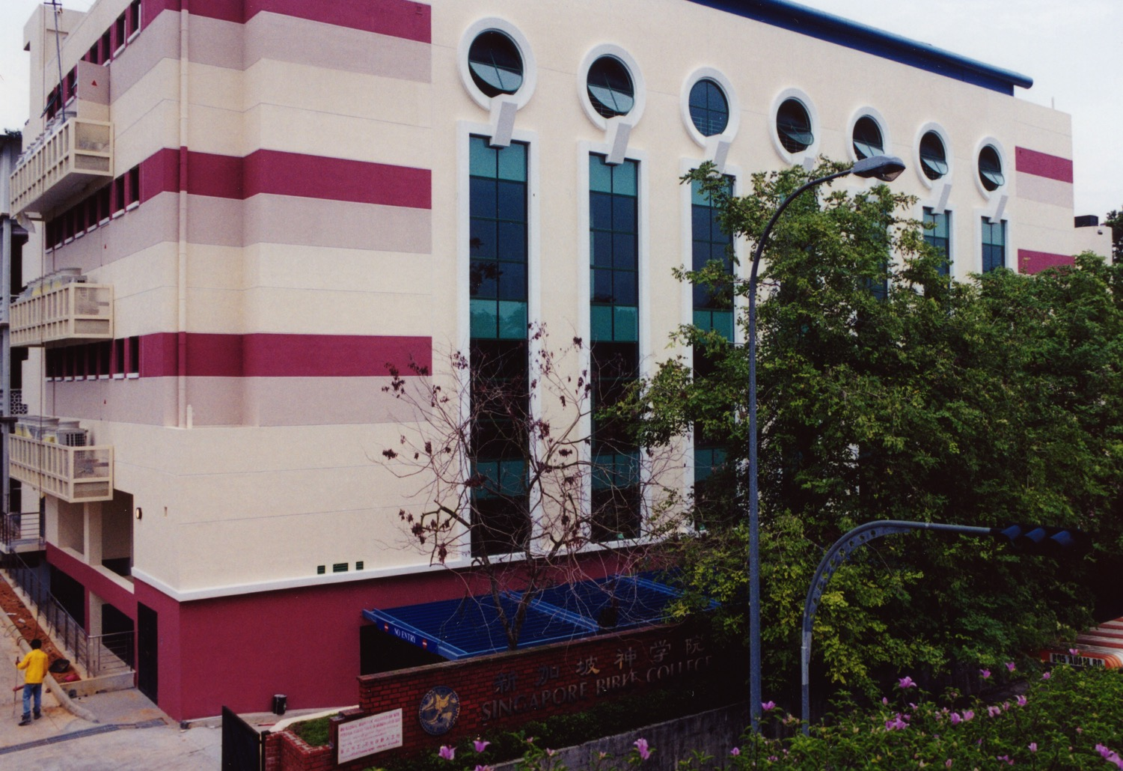
كلِّيَّة سنغافورة للكتاب المقدَّس
Notes:
خدمتُ في الفترة ما بين 1991-2021م كأستاذٍ جامعيٍّ في كلِّيَّة اللاهوت صمن فريقٍ يتألَّف من 30 عضوًا من أعضاء الهيئة التدريسيَّة في أكبر كلِّيَّة للتدريس في سنغافورة وهي: كلِّيَّة سنغافورة للكتاب المقدَّس.
___________
Common-71

Slide 7
طلَّاب كلِّيَّة سنغافورة للكتاب المقدَّس
أمريكا
منغوليا
اليابان
كوريا
الصين
هونغ كونغ
ميانمار
الهند
تايلاند
فيتنام
الفلبين
ماليزيا
سنغافورة
سريلانكا
أندونيسيا
SBC
Notes:
جاء أولئك القادة الأُمناء من 25 دولةً تقريبًا، وقد جاءوا إلينا في سنغافورة للحصول على شهاداتٍ على مسنوى الماجستير والدكتوراه. وقد قمنا بتدريبهم لكي يساعدوا بدورهم في بناء حياة آخَرين في بلادهم الأصليَّة.
___________
Common-76

Slide 8
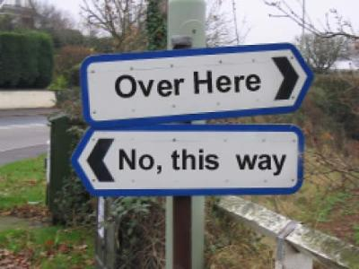
ما هي مشيئة الله بالنسبة لك ؟

Slide 9
مشيئة الله ؟
الزواج
الخدمة
؟
العمل
Notes:
What is God's will for you? Do you wonder what "door" before you is God's will?
• Your job has lost its challenge.
• Your ministry may be coming to an end.
• Your desire for a life partner still hasn't been fulfilled.
• Some other area of your life causes you to seek what God may have in store.

Slide 10
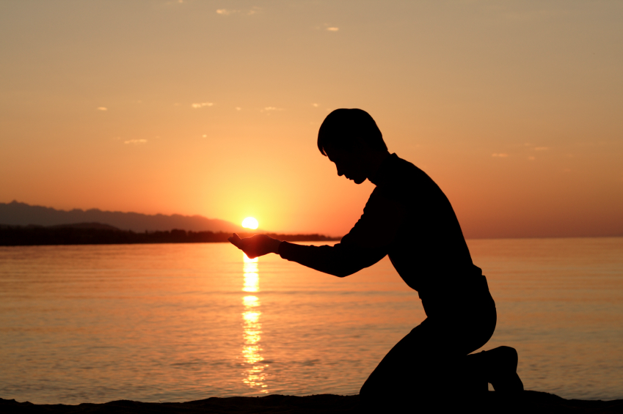
كيف تصنع مشيئة الله بدلاً من مشيئتك ؟
Notes:
How can you do God's will rather than your own? How can you make sure that your own will isn't getting in the way?

Slide 11
ملكين
ثلاثة مبادئ لمعرفة مشيئة الله
Notes:
Two kings who struggled with knowing God's will answer this question.
As we study them, we will see three principles to help us discern God's will. (Two give us the HOW and the last the WHY.)
One warning these two kings teach us in seeking God's will is…

Slide 12
1. لا تقل أنك تريد مشيئة الله عندما تكون قد اتخذت قرارك بالفعل (1 مل 22: 1-4)
Notes:
Don't claim that you want what God wants when you want what you want.

Slide 13
التهديد الآرامي
1 ملوك 22 : 1 - 4
بلاد ما بين النهرين
آرام
بن-هدد
البحر العظيم
إسرائيل
آخاب
يهوذا
يهوشافاط
الخليج الفارسي
مصر
Notes:
The situation in today’s text centers around the response of two kings to an enemy king.
• Aram or Syria was the controlling enemy country headed up by Ben-Hadad, their king. (Think "B" for Bad.)
• Israel was directly to the south with its angry, wicked king Ahab. (Think "A" for angry.)
• Farther south was Judah, whose king Jehoshaphat was mostly righteous [22:43]. (Think "J" for the Judah king Jehoshaphat who loved Jehovah.)
• Ahab and Jehoshaphat united to fight Ben-Hadad over the city of Ramoth Gilead.

Slide 14
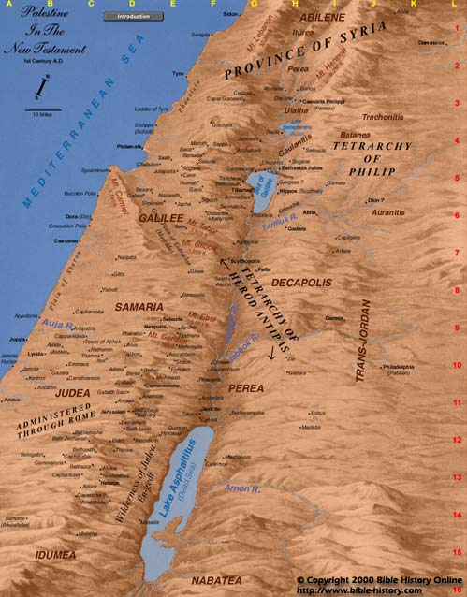
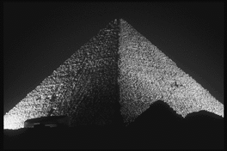
طريق البحر
ارام
إسرائيل
راموت جلعاد
مجدو
يهوذا
Egypt
Notes:
At issue was the strategic city of Ramoth Gilead.
Israel already controlled the north-south trade international route called "the way of the Sea" at Megiddo, but Israel also wanted control over the east-west spice and caravan trade to gain the monopoly on international trade. Ramoth Gilead lay on this strategic east-west international trade route.
Ben-Hadad had already promised to return Ramoth Gilead along with the other cities seized from Israel (20:34) but he still hadn't yet done it after three years.
So Ahab wanted to take back Ramoth Gilead from the Arameans and he enlisted Jehoshaphat's help (2-4).
Yet notice that Ahab hasn't even considered asking the Lord's will in this matter. He just feels there's an injustice and he's going to take it into his own hands to rectify it.

Slide 15
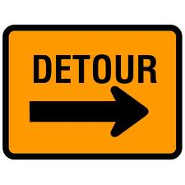
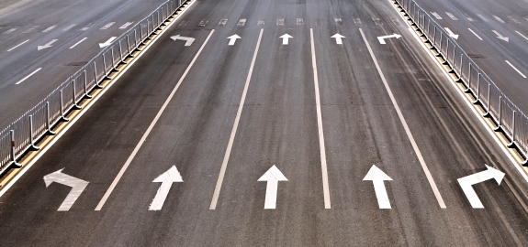
هل تطلب مشيئة الله ولكن قرارك اتخذ بالفعل؟
Notes:
How about you?

Slide 16
يا رب استخدمني بحسب مشيئتك وخصوصاً كمستشار
Notes:
Sometimes we simply want Him to rubber-stamp our own plans. An old preacher once prayed, “Lord use me as You will—especially as an advisor!”

Slide 17
إرادة الله ؟
Notes:
You've already decided that you're going to change jobs—or you're not going to.
You're not willing to move—or you are insistent that you must move.
You've committed to marry that person even before finding out what God says.
We do this all the time—make up our minds and then, as an afterthought, we ask God. Do you pray, "Approve my plan, God!"

Slide 18
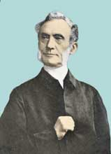
أسعى في البداية إلى إدخال قلبي في مثل هذه الحالة بحيث لا يكون لديه إرادة خاصة به فيما يتعلق بمسألة معينة
جورج مولر (1805-18989)
Notes:
Or are you willing to follow George Mueller's advice?
Maybe you've heard of George Mueller, the German missionary to England in the 1800s. He founded many orphanages and saw God answer over 50,000 prayers in his lifetime. He kept a meticulous journal of his requests and God's answers. I know of no one else who seized the will of God more than Mueller.
Here is his first step in discerning God's will that he followed in his lifetime of over 92 years (1805-1898):
• "I seek at the beginning to get my heart into such a state that it has no will of its own in regard to a given matter [repeat]."

Slide 19
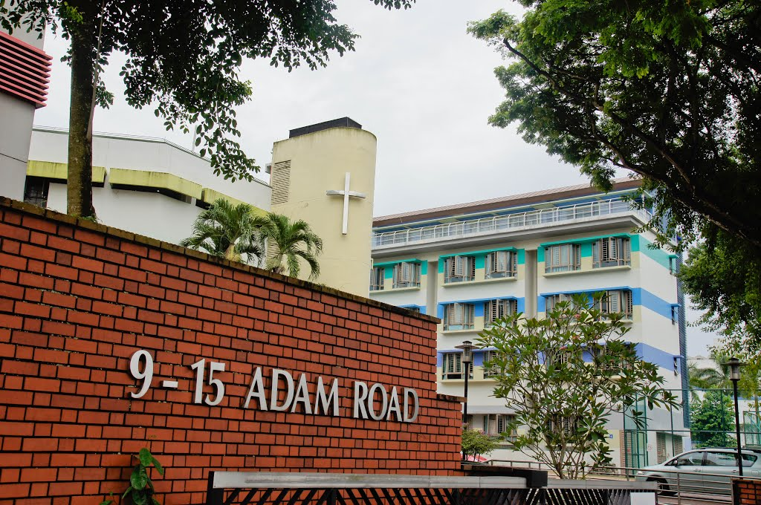
كم الفترة ؟
Notes:
People often ask, "How long do you plan to stay in Singapore?" as if this is my decision! We haven't got marching orders from the Commander-in-Chief to go elsewhere yet!

Slide 20
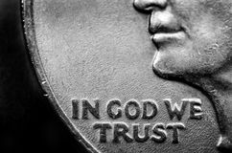
Subject?
Notes:
The US Congress adopted "In God We Trust" as the national motto on 30 July 1956. This was the high point of US history, a time of the greatest wealth, morality, security, and just about every measure you can think of. Sadly, the country soon abandoned such a commitment and by 1962 threw prayer out of the schools. It has been mostly downhill since because the USA claims to trust God but does not do so.

Slide 21
1. لا تقل أنك تريد مشيئة الله عندما تكون قد اتخذت قرارك بالفعل (1 مل 22: 1-4)

Slide 22
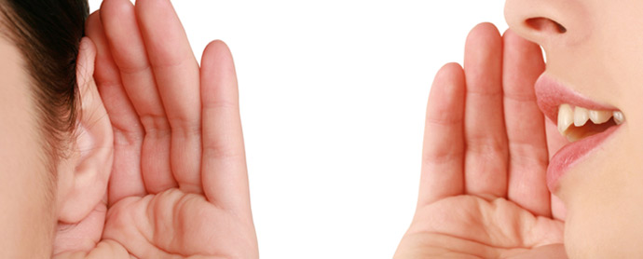
لكن هل يجب أن تحصل على مشورة من الآخرين؟
Notes:
Of course, but here is a caution in the next movement of the story…

Slide 23
2. لا تطلب مشورة فقط من هؤلاء الذين يقفون إلى جانبك (1 مل 22 : – 28)
Notes:
Avoid getting your security in friends or family if they aren’t seeking God.

Slide 24
1 ملوك 22 : 5 - 28
Notes:
[Ahab's decision to attack was rubber-stamped by his pagan advisors even though he knew God prohibited it (5-28).]
Jehoshaphat requests a prophet to tell them whether the battle is God's will (5).
But Ahab prefers to have his pagan prophets rubber-stamp his plan (6).
Now don't get fooled by the word "prophets" here. These are not really men who knew the future, but only court advisors paid by the king (see 18:19). Kings then typically requested counsel from their own and got encouragement in numbers.
Will they counsel against a king who's already made up his mind? Hardly!
Sometimes even unbelievers pretend to speak for the Lord (6, 11-12). My non-Christian parents tried to convince me to become a businessman after I graduated from business school. They said this is how I could serve God.
Still Jehoshaphat insists that God's true prophet must be consulted (7).
[Ahab reluctantly hears Micaiah's message of judgment but rejects it (8-28).]
After Micaiah's sarcastic prediction of success, he tells them plainly that Ahab will die in the battle (17).
In fact, a demonic plan was already in operation to accomplish God's will!
So Ahab foolishly sought to get his decision rubber-stamped by his pagan advisors even though he knew God prohibited it.
(This brings up an important question for you and me…)

Slide 25
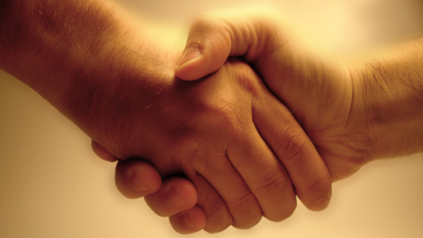
هل تطلب النصيحة الإلهية في سعيك وراء مشيئة الله؟
Notes:
Are you seeking godly advice in your pursuit of God's will? When we want advice, sometimes we ask only those whom we know will give us a favorable answer (6).
How much better to go to those who really know the situation!

Slide 26
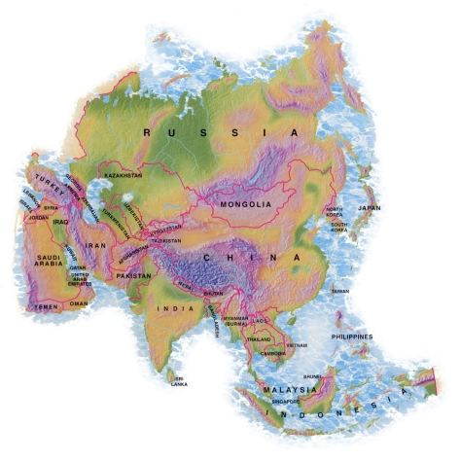
منغوليا ؟
Notes:
Back in 1998 after my second trip to Mongolia with my wife Susan I was asked to lead the small, fledging Bible school there. So we began to pray that God would really show us His will in the matter. I even cautioned my departmental dean at SBC that I might be transferring to Mongolia. But then, with hesitation, I asked my mission director. Why with hesitation? Because John knew me better than I knew myself, in certain ways. I was afraid he might say it wasn't that great of an idea. He said frankly, "I don't think that's a good fit for you and Susan." As it turned out, I didn't go after all, but I learned to get advice from those not "one my side."
(I was glad I sought godly advice. But what's the result from stubbornly pursuing our will rather than God's?)

Slide 27
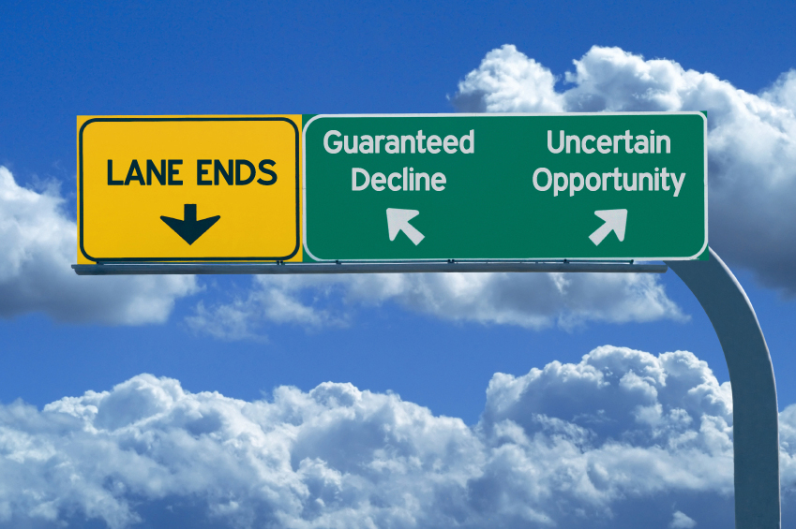
3. تجاهل إرادة الله الواضحة أمر كارثي (1 ملوك 22: 29-40)
Notes:
We should fear the consequences when we know what God wants but refuse it.
Sometimes God closes one door and opens another one that seems risky.
To refuse that uncertain opportunity is to guarantee decline.

Slide 28
1 ملوك 22 : 29 - 40
Notes:
[Ahab's stubborn disregard for God's will led to his death at Ramoth Gilead (29-40).]
Ahab's disguising himself in battle looked like it would save him from death (29-33).
[But a random arrow killed Ahab to fulfill Micaiah's prediction of his death (34-38).]
The soldier shot his arrow without even aiming, yet he had no idea that God had a GPS (God's Positioning System) device on it right towards Ahab! Ahab should have known that no disguise could thwart God's will.
Ironic, isn't it? "Jehoshaphat went into battle in his royal robes and the Lord protected him; but Ahab in his disguise was slain."

Slide 29
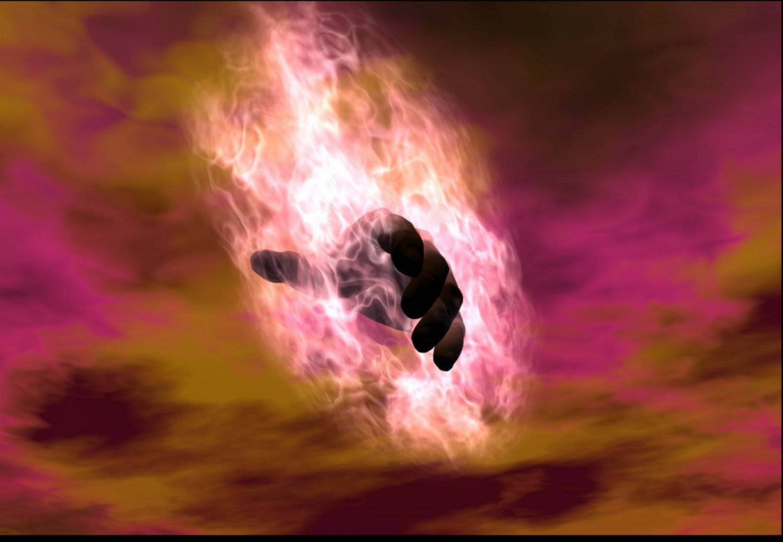
ما الذي ينتج من طلب مشيئتك بدلاً من مشيئة الله ؟
Notes:
Maybe it won't be death—but something worse! But what could be worse?
How about leanness in your soul?
Or wouldn't living for yourself rather than for Christ be worse than death?
(On the other hand…)

Slide 30
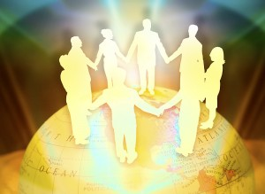
ما الذي ينتج من طلب مشيئة الله ؟
Notes:
It's great from then on, right? What did Micaiah get for his faithful ministry? Bread and water in prison!
But he lived! And his conscience was clear, knowing that he was truly God's servant!

Slide 31
كيف تصنع مشيئة الله بدلاً من مشيئتك ؟
Notes:
So what did we learn from 1 Kings 22?
How can you do God's will rather than your own? How can you make sure that your own will isn't getting in the way?

Slide 32
1. لا تقل أنك تريد مشيئة الله عندما تكون قد اتخذت قرارك بالفعل (1 مل 22: 1-4)
Notes:
I’ve actually shared two ways to do God’s will. This first way relates to SINCERITY.

Slide 33
2. لا تطلب مشورة فقط من هؤلاء الذين يقفون إلى جانبك (1 مل 22 : – 28)
Notes:
This second way to do God’s will relates to SOURCES.

Slide 34
3. تجاهل إرادة الله الواضحة أمر كارثي (1 ملوك 22: 29-40)
Notes:
Here we see WHY we should do God’s will instead of our own!

Slide 35
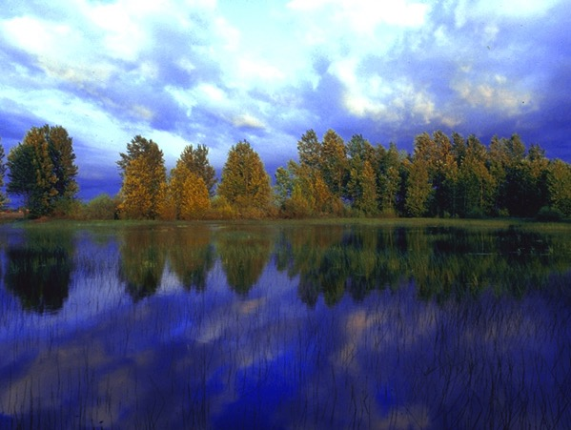
—الفكرة الرئيسية في 1 ملوك 22— أطلب الرب بإخلاص لأن تجاهل إرادة الله الواضحة له نتائج خطيرة
Notes:
You may face 400 to 1 odds like Micaiah—but you still must obey God .
Frankly, there's only one vote that counts—the Lord's.

Slide 36
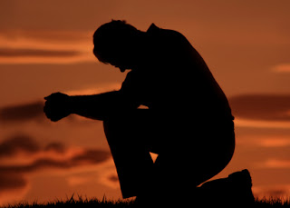
خذ وقتاً مستقطعاً

Slide 37
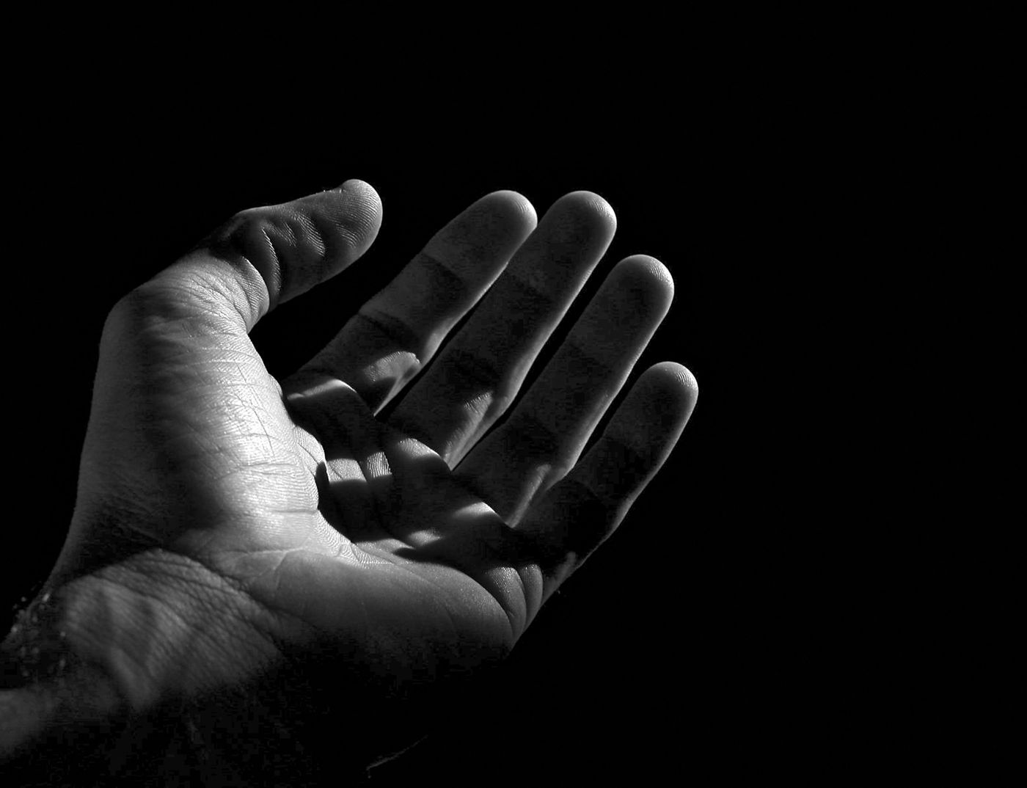
افتح يدك
عندما تكون مشيئتك هي نفس مشيئة الله
سوف تحصل على مشيئتك
––تشارلز سبرجن

Slide 38
الرابط للعرض التقديميِّ "علم الروح القدس (نيوماتولوجيا)" متاحٌ على الموقع الإلكترونيّ: BibleStudyDownloads.org
أحصل على هذا العرض التقديمي مجانًا!
Notes:
HS Holy Spirit (Pneumatology) in Arabic
_____________
Common-23

Slide 39
Black

